Slide 1



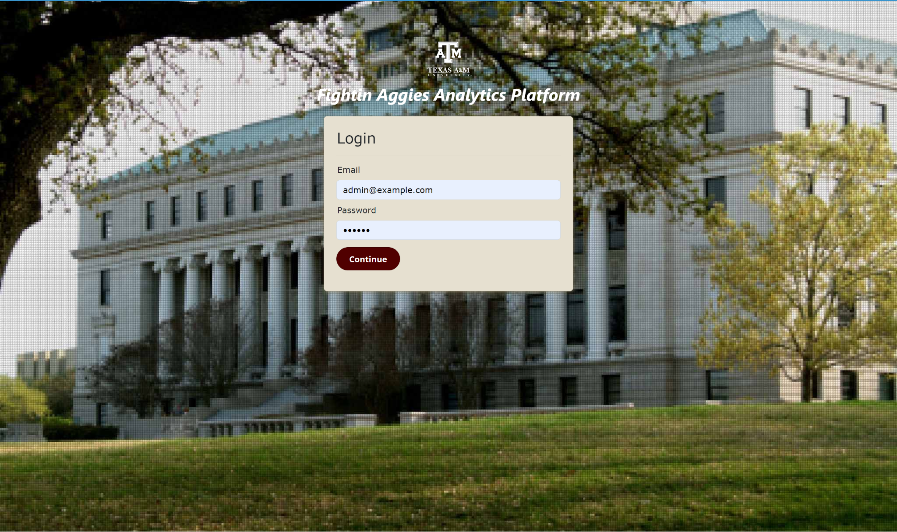
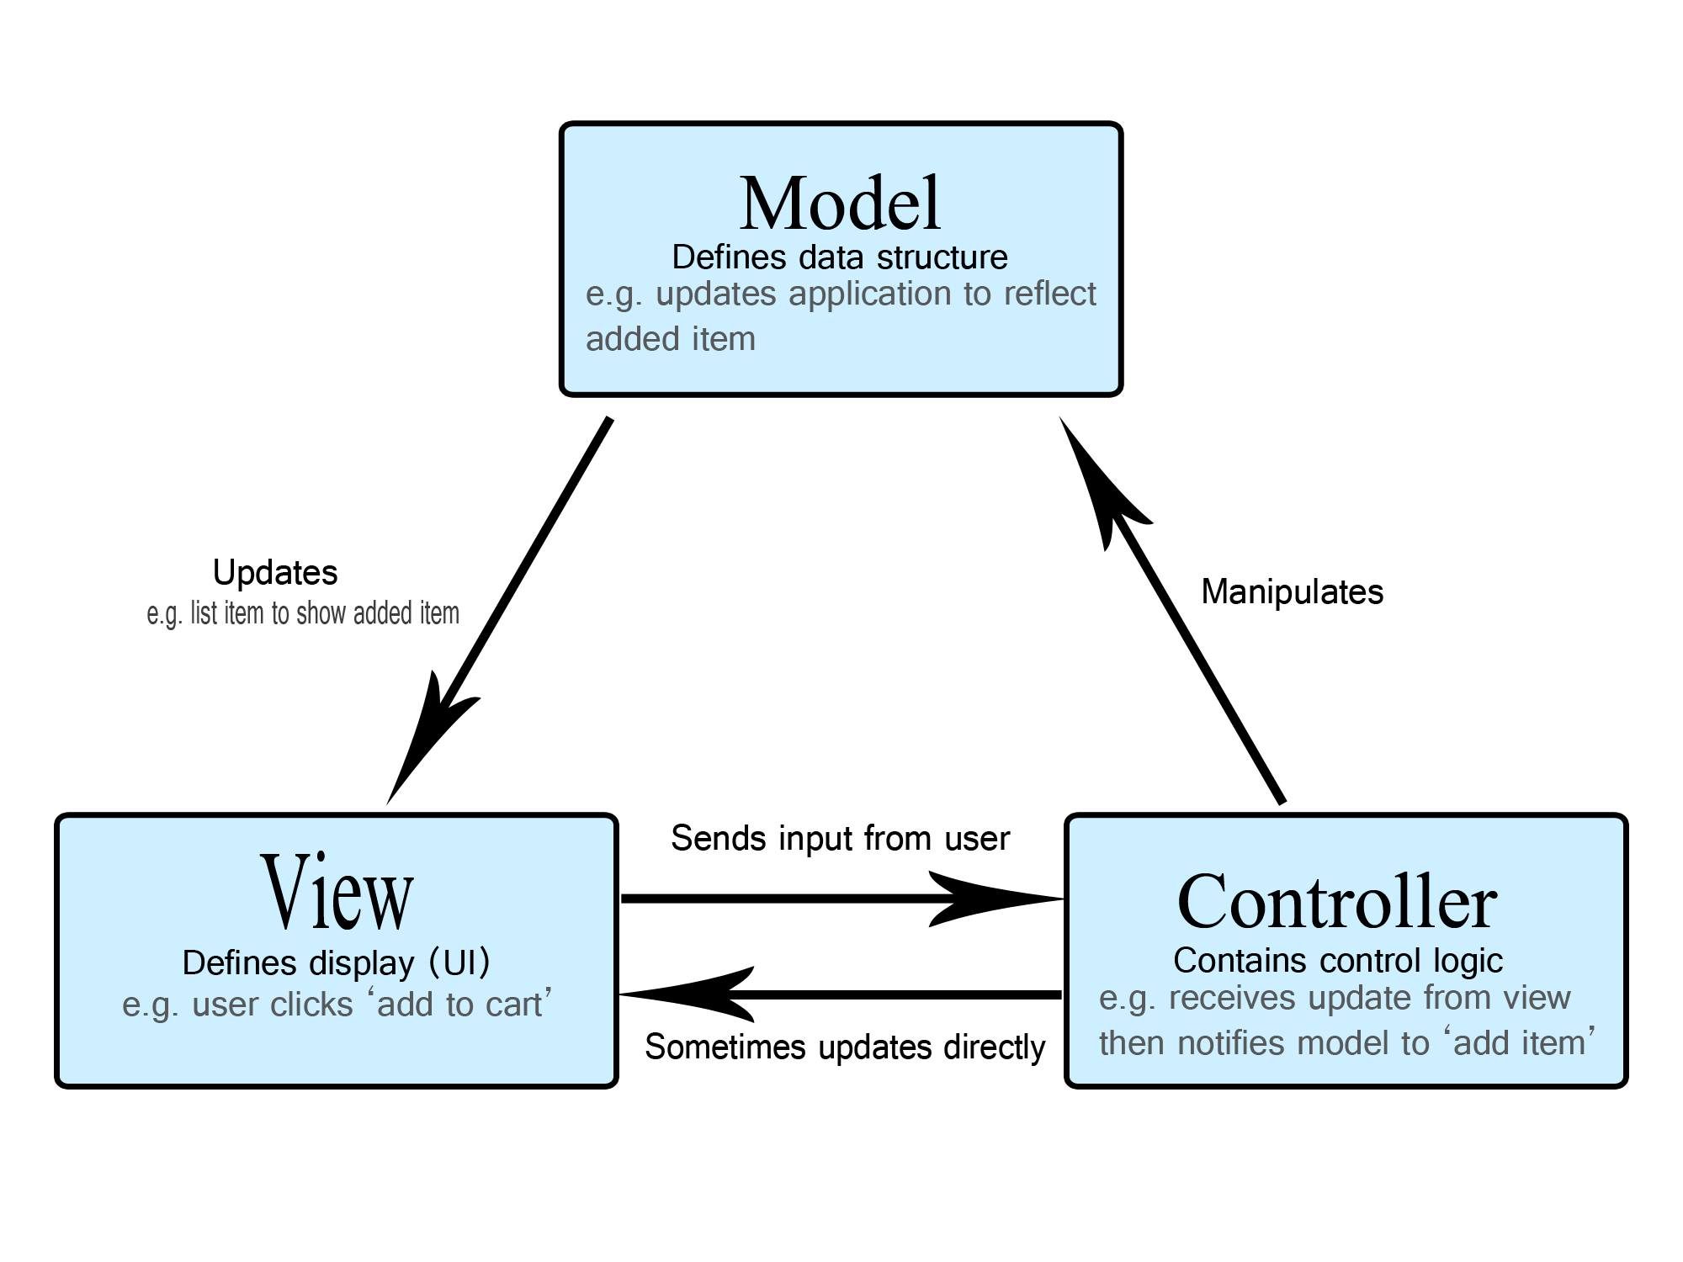
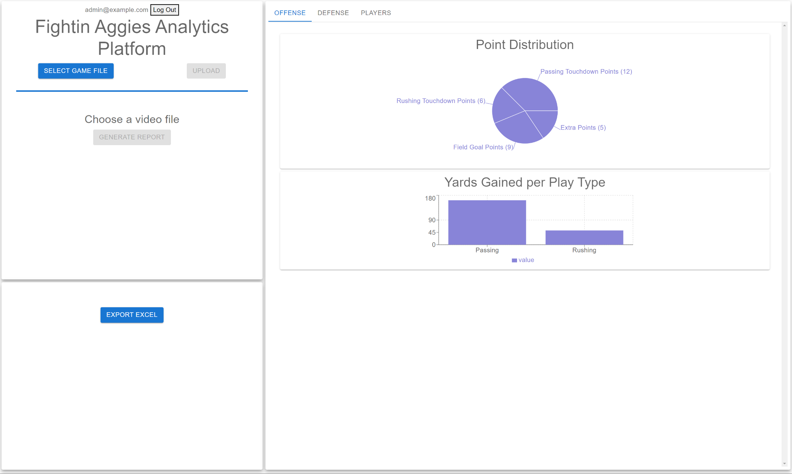

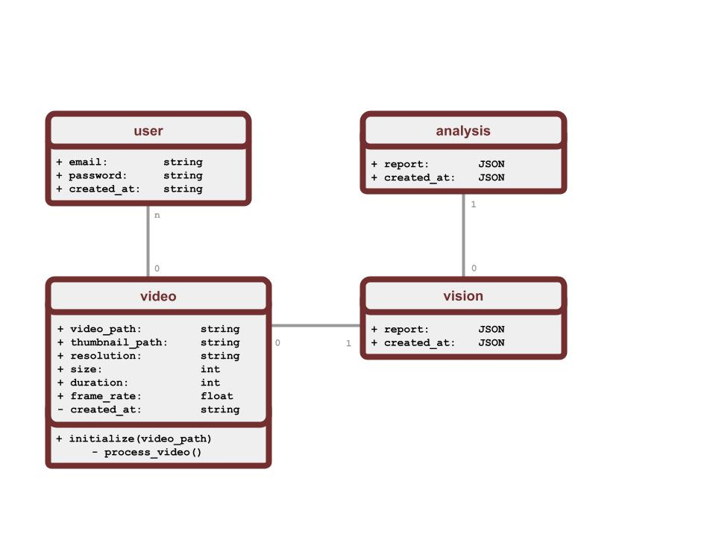
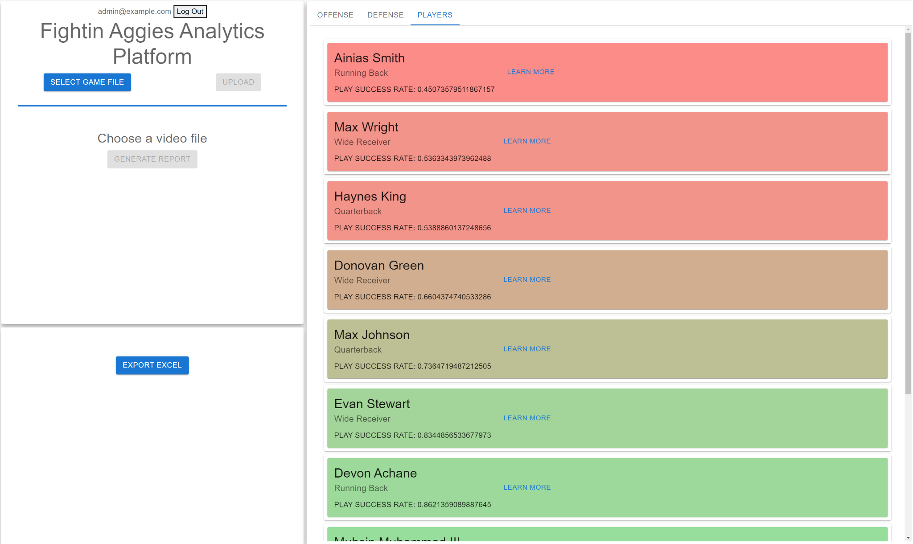
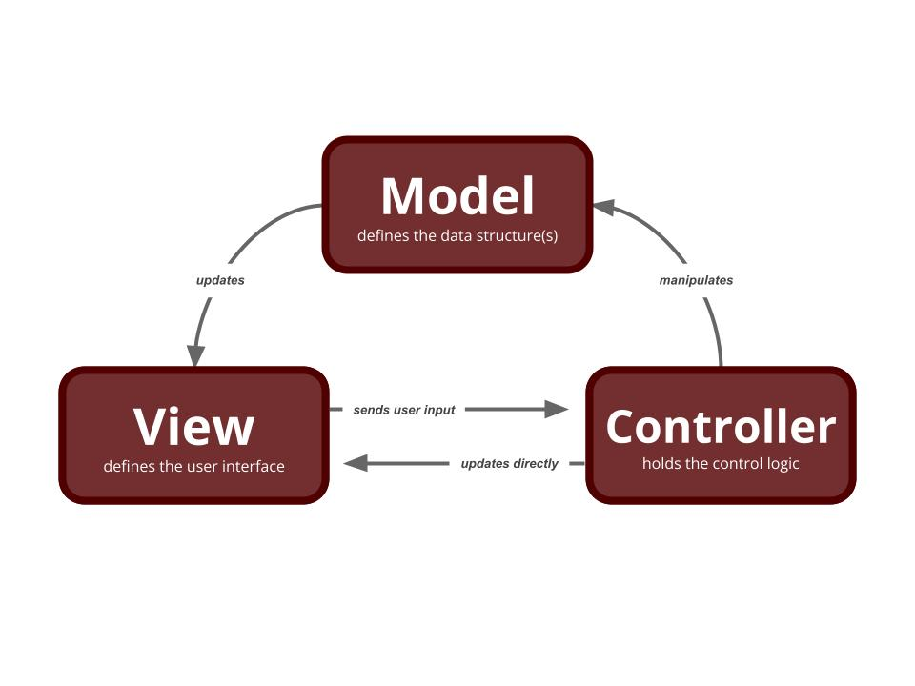
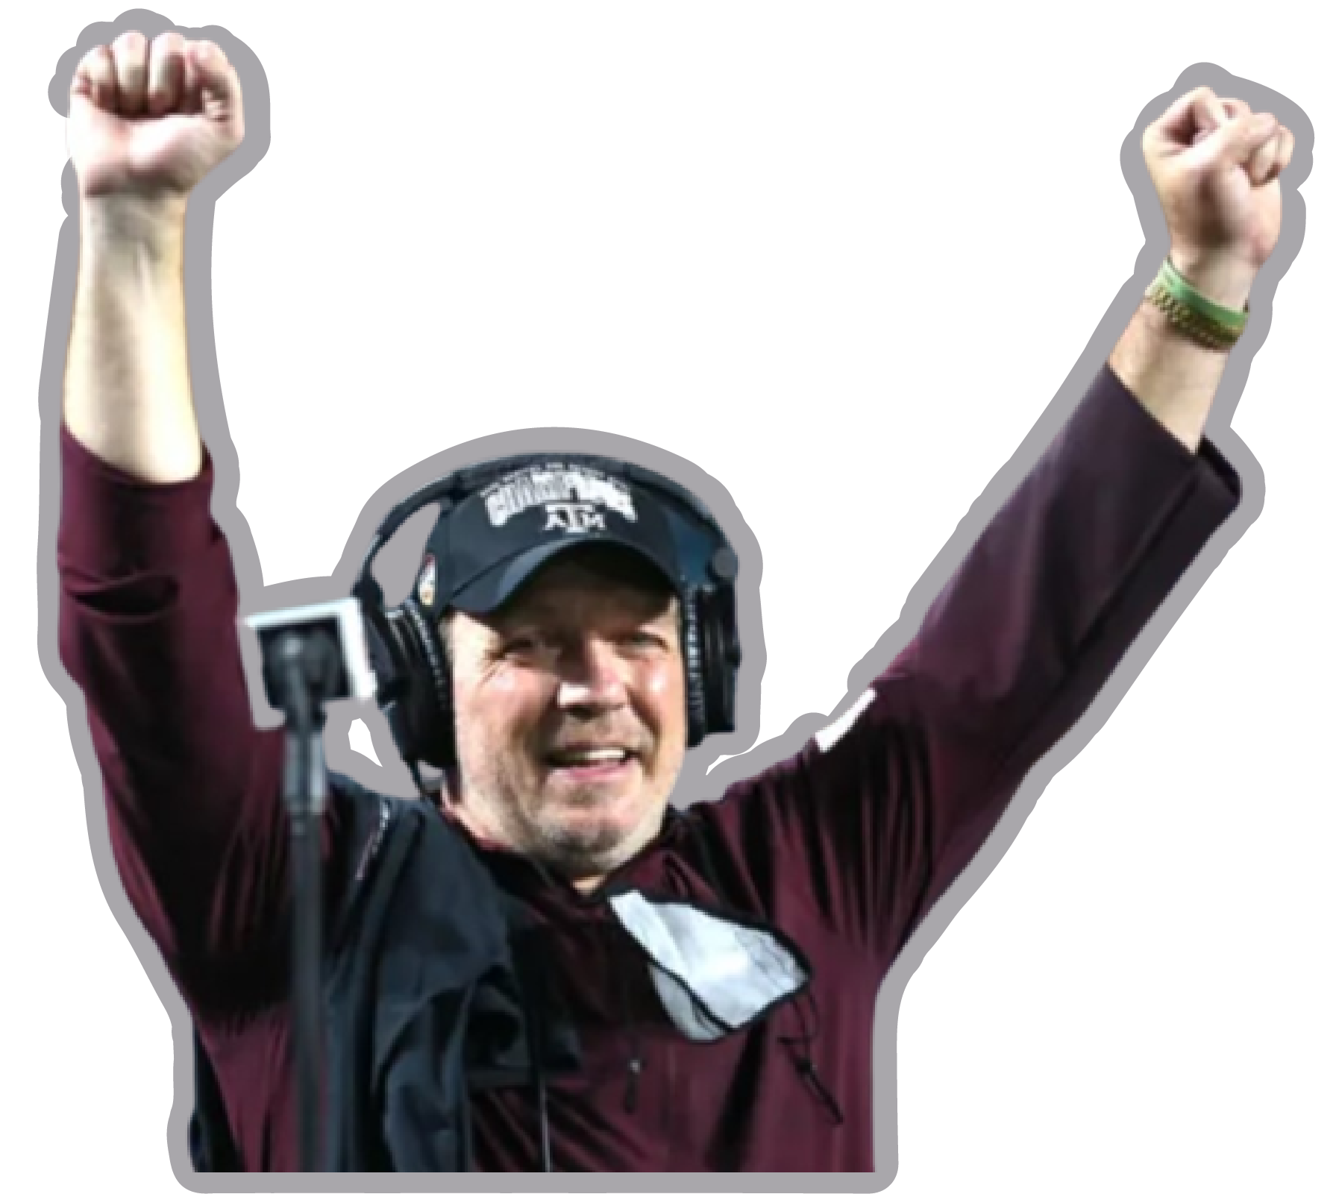
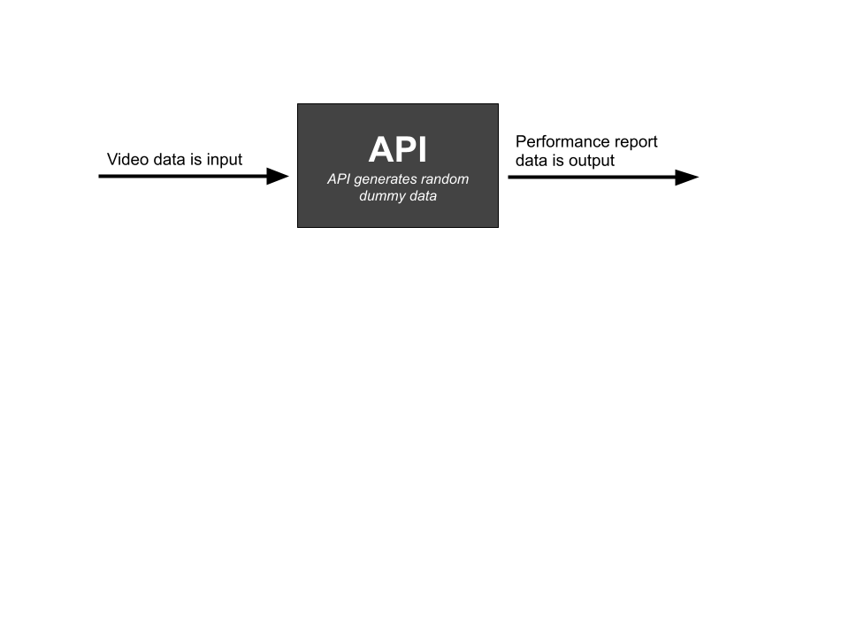

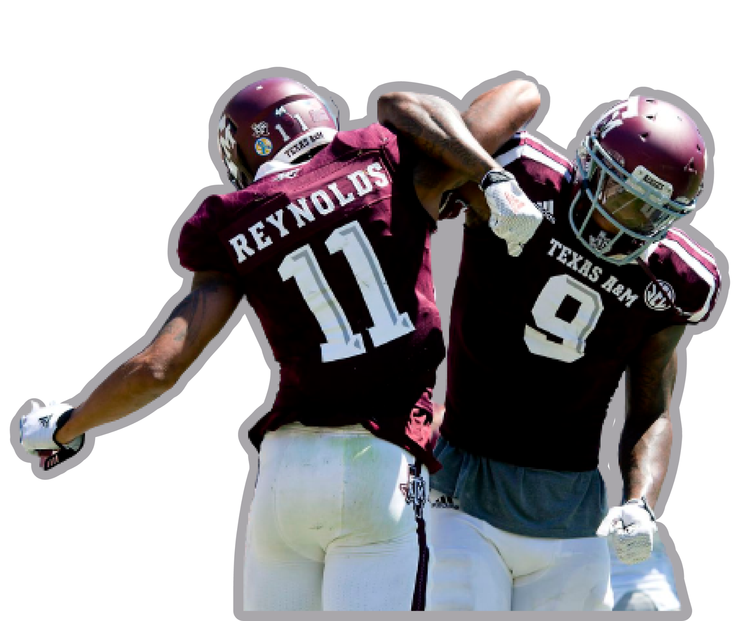
The poster/slide(s) should introduce
your application
your design
challenges and lessons you have learned about the software engineering process
CSCE-606.600
Fall 2022
Fightin’ Aggies Platform
Player/Team Performance Reviewing Tool
Jesse Phipps, Pedro Henrique Villar de Figueiredo, Ryan Kafka, Siddhant Thakur, and Xintong Wu
Simple buttons used to access various functions
Controllers connect the models to the frontend
Talk about fact that the dashboard is programmable,
Based on the back-end
JSON based
Dynamic
Link to Web Application
Design
https://fightin-aggies.herokuapp.com/
Simple two-page frontend
Log-In Page:
Dashboard:
home page holding all user-desired functionality
Created a Black-box API
Generates results for hundreds of plays per upload
Introduction
Client: The Texas A&M Football Team
Objective:
Consolidate data captured from Texas A&M Football games/practices
Solution:
Develop a web-based platform that _____
Derive performance ratings for individual players
Provide access to player performance ratings
Architecture
Misc. logos & assets
Challenges & Lessons
Original project description was geared towards building a machine learning model
inconsistent with expectations of the class
We could not secure clearance to the necessary data
Our client was hard to reach
eventually stepped away
Lack of real data
Integration efforts chewed through unexpected amounts of time
Deployment issues with Ruby on Rails
Lessons
Taking the time on initial planning limits miscommunication & debugging
Embracing Test-Driven Development makes development much more sustainable & consistent
Learned the expectations of Product Owner and Scrum Master roles
Struggles with Ruby On Rails led to use
of Cloud9 for easier deployment

